Slide 1
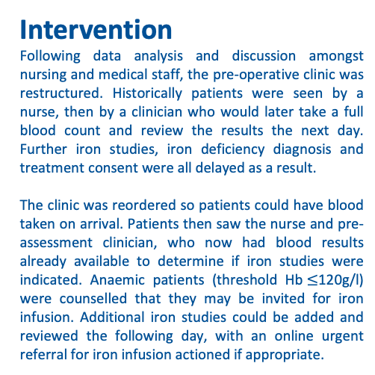
Gynaecology - oncology pre-operative anaemia assessment and treatment; a Quality Improvement Project
*Matthew Cadd¹, Rosemarie Patterson², Rahul Bagga², Peter Larsen-Disney², Lynne Campbell¹
1. Department of Anaesthesia, Brighton & Sussex University Hospitals Trust
2. Department of Gynaecological Oncology, Brighton & Sussex University Hospitals Trust
Introduction
Treatment of anaemia in the pre-operative setting has been shown to produce higher pre-operative haemoglobin and reduce the requirement for subsequent blood transfusions (1). Inadequately treated pre-operative anaemia is associated with increased rates of acute kidney injury, adverse cardiovascular events and mortality in the post-operative period (2)
Patients with gynaecological malignancy frequently become anaemic due to their underlying disease and require surgeries that are high risk for estimated blood loss >500mls and blood transfusion (3). Sub group analysis of a multicentre study showed 64% of gynaecology patients to be anaemic and of those nearly 80% had absolute iron deficiency (4).
Pre-operative assessment and subsequent treatment can be challenging in this patient cohort owing to the urgency of their surgery. Adequate treatment of these patients requires timely and efficient assessment. In this Quality Improvement Project, we sought to review current strategies and how they could be modified to improve assessment and subsequent treatment of iron deficiency anaemia.
Methods
We retrospectively analysed all gynaecology-oncology patients who had been seen in pre-operative assessment clinic in 2019. Pre-operative haemoglobin, mean corpuscular volume, C-reactive protein and iron studies were recorded.
Intervention
Following data analysis and discussion amongst nursing and medical staff, the pre-operative clinic was restructured. Historically patients were seen by a nurse, then by a clinician who would later take a full blood count and review the results the next day. Further iron studies, iron deficiency diagnosis and treatment consent were all delayed as a result.
The clinic was reordered so patients could have blood taken on arrival. Patients then saw the nurse and pre-assessment clinician, who now had blood results already available to determine if iron studies were indicated. Anaemic patients (threshold Hb$≤$120g/l) were counselled that they may be invited for iron infusion. Additional iron studies could be added and reviewed the following day, with an online urgent referral for iron infusion actioned if appropriate.
Results
Following the reorganisation of the clinic there was a notable increase in the number of iron studies and CRP tests sent for pre-operative patients. Importantly, there was a near sixfold increase of anaemic patients having all three necessary additional blood tests taken. Before intervention there were 6 pre-operative iron infusions in all of 2019, following the change there were 5 infusions in the first 3 months of 2020.
The COVID-19 pandemic has disrupted the gynae-oncology pre-operative pathway, with outsourcing to a local independent hospital without the facility to provide iron infusions. Although not displayed in this data, the diagnostic improvement continued later on in the 2020 cycle with 7 out of 10 anaemic patients receiving full blood testing, although those that met the criteria were not able to be treated with an iron infusion.
Discussion
Although the recent PREVENTT trial did not show a reduction in transfusion requirement following pre-operative intravenous iron therapy, NICE guidelines for pre-operative anaemia assessment and treatment continue to be pertinent (5, 6). Our current haemoglobin threshold (120g/l) is lower than recommended (1, 3); we plan address this as capacity to deliver iron infusions is expanded.
We aim to continue monitoring our reconfigured pre-op assessment strategy, with improved diagnostic blood testing for anaemia. Data collection is ongoing on iron infusion therapy and the subsequent effect on post-operative outcomes in this patient group.
References
1) Munting KE, Klein AA. Optimisation of pre‐operative anaemia in patients before elective major surgery–why, who, when and how?. Anaesthesia. 2019 Jan;74:49-57.
2) Fowler AJ, Ahmad T, Phull MK, et al. Meta-analysis of the association between preoperative anaemia and mortality after surgery. British Journal of Surgery. 2015.
3) Muñoz M, Acheson AG, Auerbach M, et al. International consensus statement on the peri‐operative management of anaemia and iron deficiency. Anaesthesia. 2017 Feb;72(2):233-47.
4) Muñoz M, Laso‐Morales MJ, Gómez‐Ramírez S, et al. Pre‐operative haemoglobin levels and iron status in a large multicentre cohort of patients undergoing major elective surgery. Anaesthesia. 2017 Jul;72(7):826-34.
5) Richards T, Baikady RR, Clevenger B et al. Preoperative intravenous iron to treat anaemia before major abdominal surgery (PREVENTT): a randomised, double-blind, controlled trial. The Lancet. 2020 Oct 24;396(10259):1353-61.
6) National Institute for Health and Care Excellence. Perioperative care in adults: NICE guideline NG180. 2020 Aug
*Correspondng author: E-mail: matthew.cadd@nhs.net
Conclusions
A considerable number of our patients present with anaemia before gynae-oncology surgery. We have shown that without additional resource or time expenditure, a relatively simple restructuring of the pre-operative clinic can lead to a significant improvement in the timely diagnosis of iron deficiency anaemia, creating a feasible treatment window for preoperative iron infusion in these patients.
Ethics
We consulted BSUHT Head of R&D who confirmed NHS REC or HRA approval was not required.
Figure 1. Percentage of patients presenting with pre-operative anaemia and of those, how many had blood tests to assess for iron deficiency

